Slide 1
Notice List Project
Kelly McKinnon and John Schindler

Slide 2
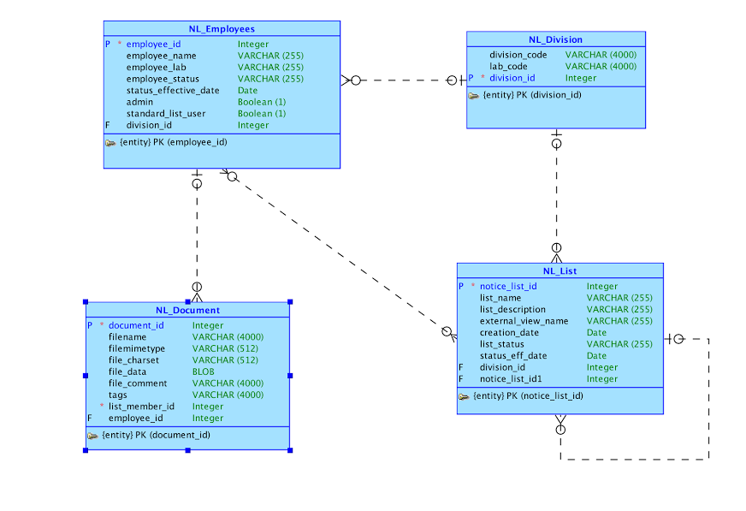
Conceptual Model

Slide 3
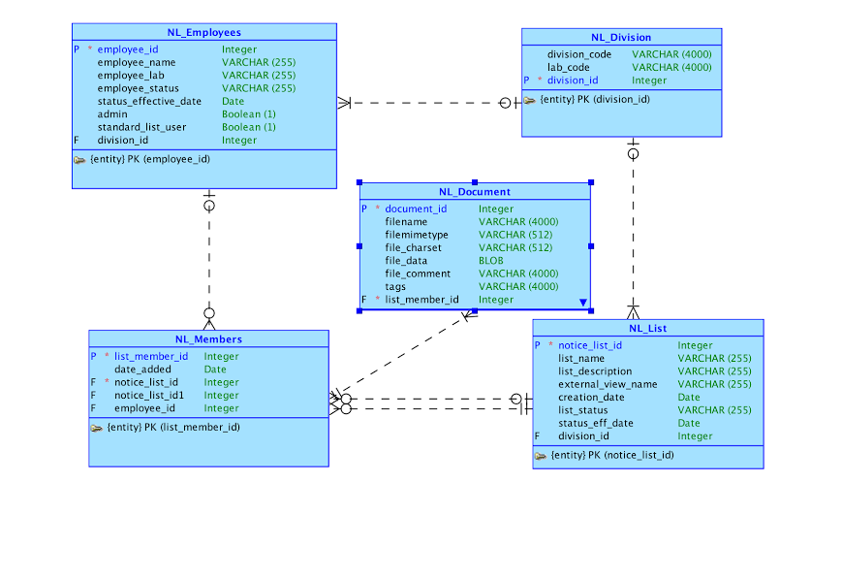
Logical Model

Slide 4
Application URL
https://apex.oracle.com/pls/apex/f?p=92218:1c

Slide 5
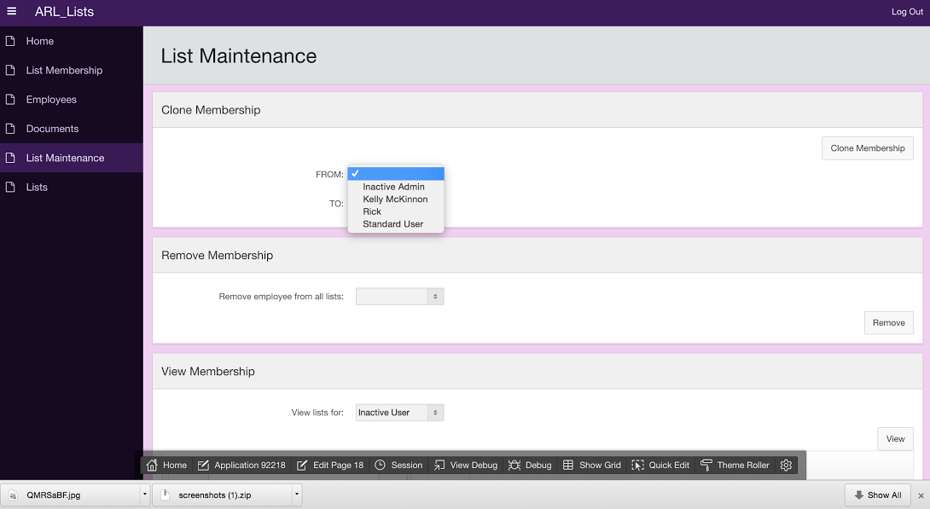
List Maintenance
Ability to clone an employee’s memberships to another employee, remove an employee from all lists, and view all lists an employee is a member of

Slide 6
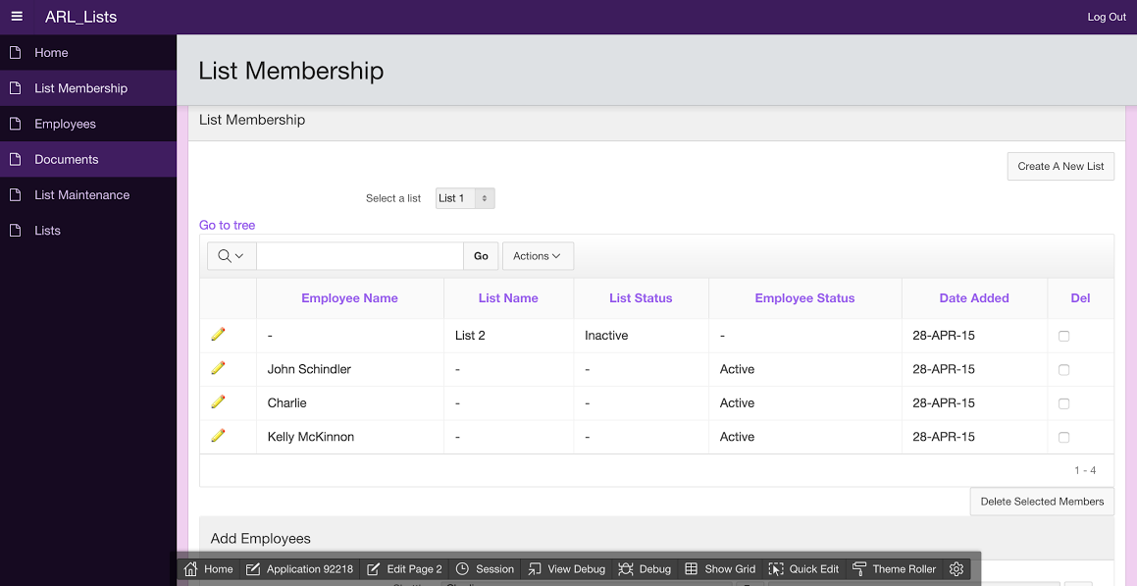
List Membership
Select a list to view a tree of its members, a table of its members, and to have the ability to add employees/lists to that list via shuttles

